Slide 1

It’s All About Snakes!
∙Snakes & Ladders
∙Snake II
BY:
Muhammad Shihab Rashid(144407) Mushfique Uddin Mahmud Rafid(144415)

Slide 2
Game Modes:
Snakes and ladders: The classic “Shaap-Ludo” game which include a dice and a board to play. Two players roll dice and the first one to reach to 100 going through obstacles such as snakes wins.
Snake II: the classic nokia snake ii game. Includes a snake and a fruit. The snake grows longer as it eats the fruit. Player has 3 lives. Players objective is to score the highest.

Slide 3
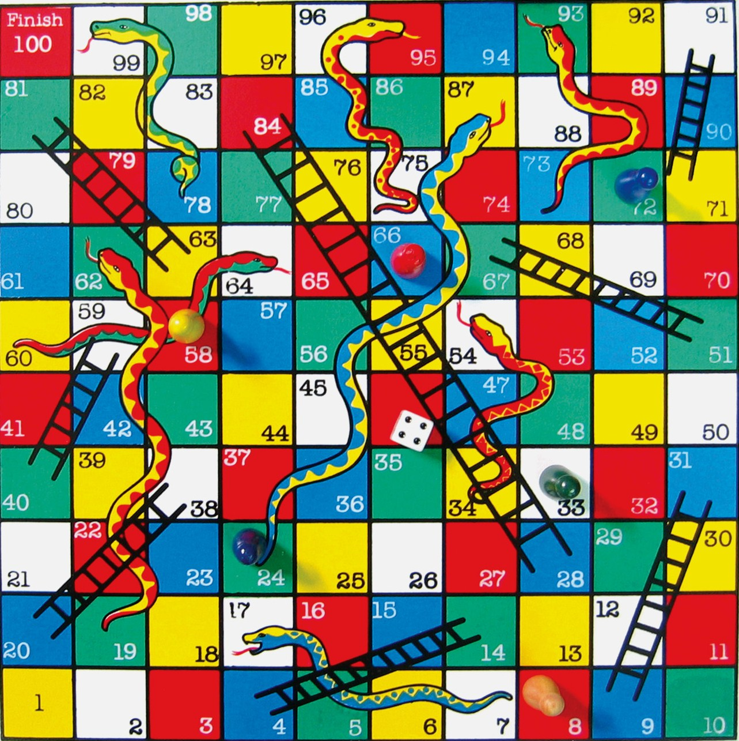
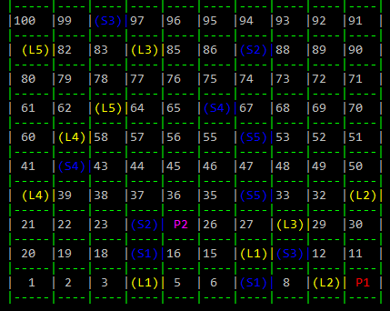
Game Overview
Original: in game:

Slide 4
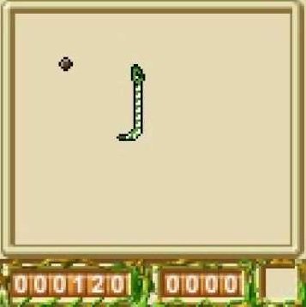
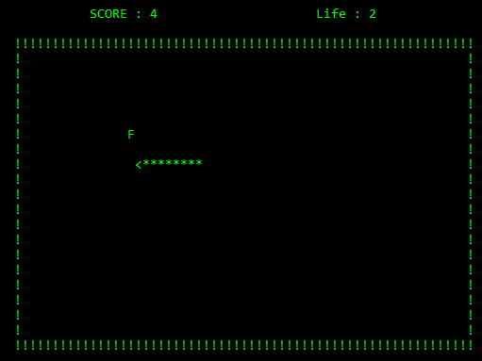
Game Overview
Original: in-game:

Slide 5
Game Features
this game is mainly written in c code and includes graphics in the form of ASCII art as well as console based attractive colors.
Snake II: records name, score, time, date of the gamer to compete between friends!
S&L: two player mode

Slide 6
How To Play:
S&L: hit enter to roll the dice and hand over the keyboard to the next player!
Snake II: use the directional keys to move the snake and try not to hit the walls or the body.
Its simple and easy!!!

Slide 7
Game Objectives
Make the gamer nostalgic
To remind the joys of childhood
Share excitement and joy
Creating fun competitions between friends

Slide 8

Source Code
for the source code let’s click the snake and play….....

Slide 9
Thank you for watching!
Feel free to ask any questions.

